Slide 1

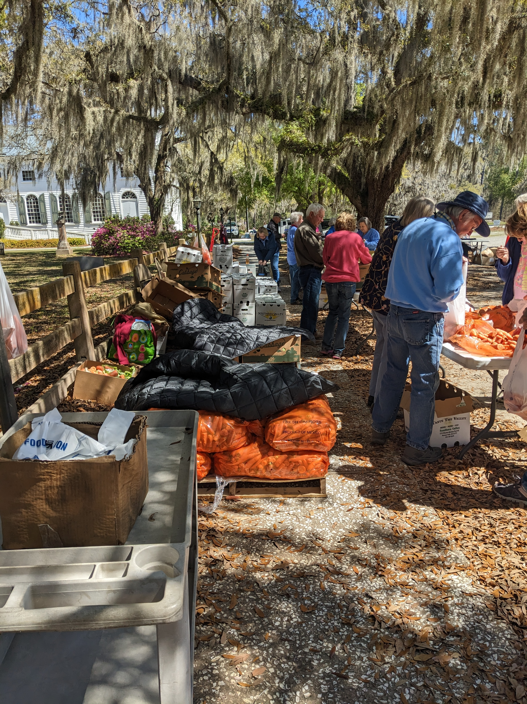
CSFP
The Commodity Supplemental Food Program

Slide 2
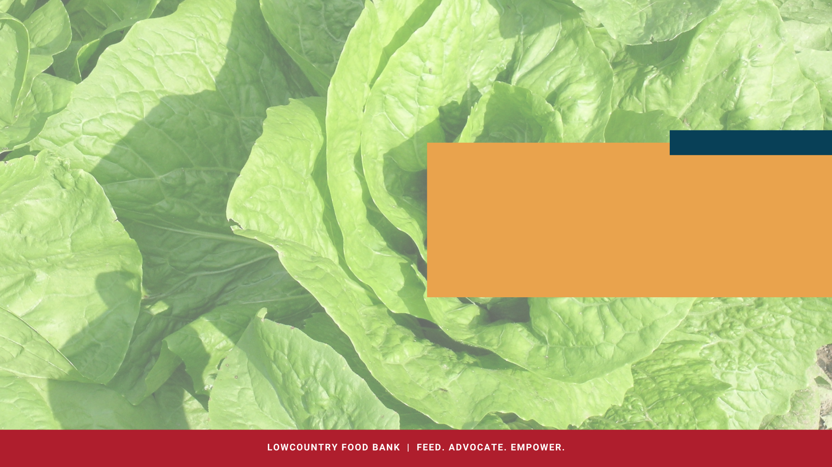
Your Kindness
Your Passion
WE APPRECIATE YOU!
Your Time
Your Energy

Slide 3
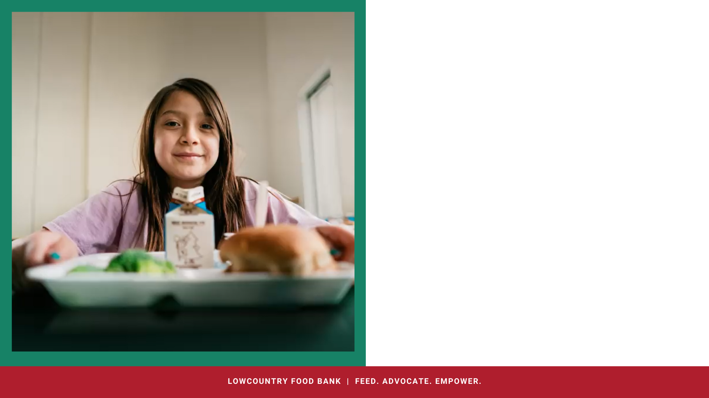

Agenda
CSFP Procedure Updates
CSFP Reminders
Inputting New Clients: Group Practice
Recap activity

Slide 4


Question!
What does CSFP stand for?
Commodity Supplemental Food Program

Slide 5
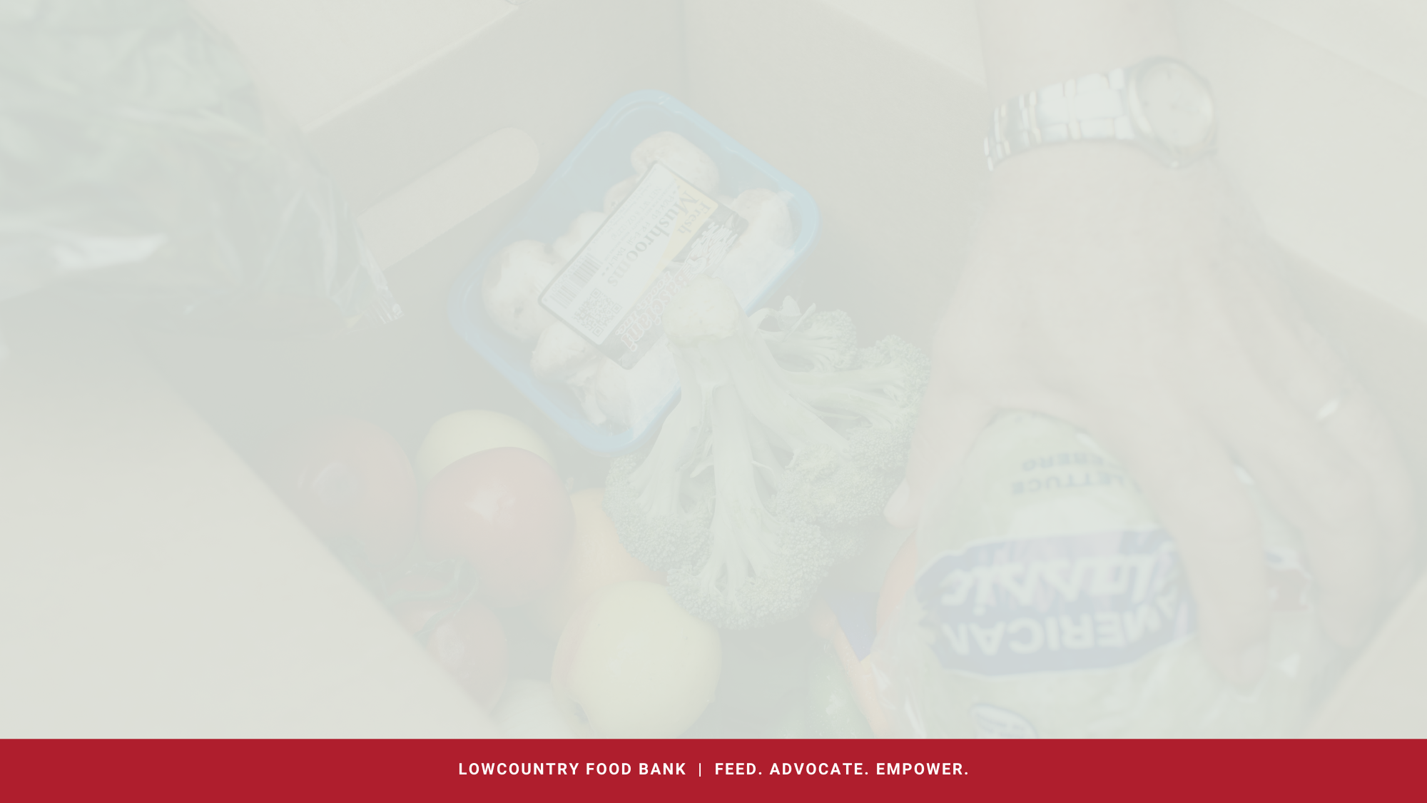

What is CSFP?
The Commodity Supplemental Food Program (CSFP) is a Federally funded program, which works to improve the health of elderly people at least 60 years of age by supplementing their diets with nutritious USDA foods. The USDA purchases food and makes it available to CSFP state agencies and Indian Tribal Organizations (ITOs).

Slide 6
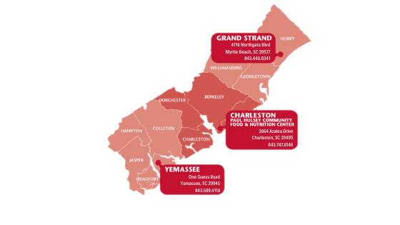
CSFP Caseload
Additional caseload!!!
In September we moved the majority of the Waiting List clients to the Active List
The Agency Relations team and a volunteer also cleaned up the waiting list and removed any clients who haven’t come in 6 or more months- please note that you may have clients that receive a closure letter and want to be readded
Our goal is 95%
Remember that your active list is reflective of how many boxes you will receive each month
Advertise for your site
Call your Active and Waiting list clients
New sites- Our goal is to add new sites this year. As we add sites, we will update our CSFP site list and send it out.

Slide 7
Thank You!
Aug 2022-Aug 2023=
40,021 CSFP Boxes
Aug 2022-Aug 2023=
800,420 pounds

Slide 8

New CSFP Manual-Coming Soon
New Civil Rights Poster
New Non-Discrimination Statement
No longer required to post Beneficiary Rights poster.
New Monthly Report: https://forms.office.com/r/ZYj8g4zvEM
No county restrictions- must serve any qualifying neighbor in the state of South Carolina
No more limits on number of neighbors
proxies can pick up for
Adding new seniors to the active list
Waiting List clients moved to the active list starting in September
What's new?

Slide 9
Question!
When are CSFP reports due? (We will accept both dates)
18th for early deliveries and the 25th

Slide 10

CSFP Timeline
The 18th and the 25th of the month
The first Monday of the month
The 2nd week of the month
3rd Monday of the month
The 4th Monday-Thursday of the Month
The first CSFP deliveries go out
I communicate how many boxes we will need for the following month to other LCFB departments to prepare menus and volunteers for packing boxes
Sort through reports and determine how many boxes have been distributed this month and set the number of boxes to send for next month
The majority of CSFP distributions happen
Reports are due

Slide 11
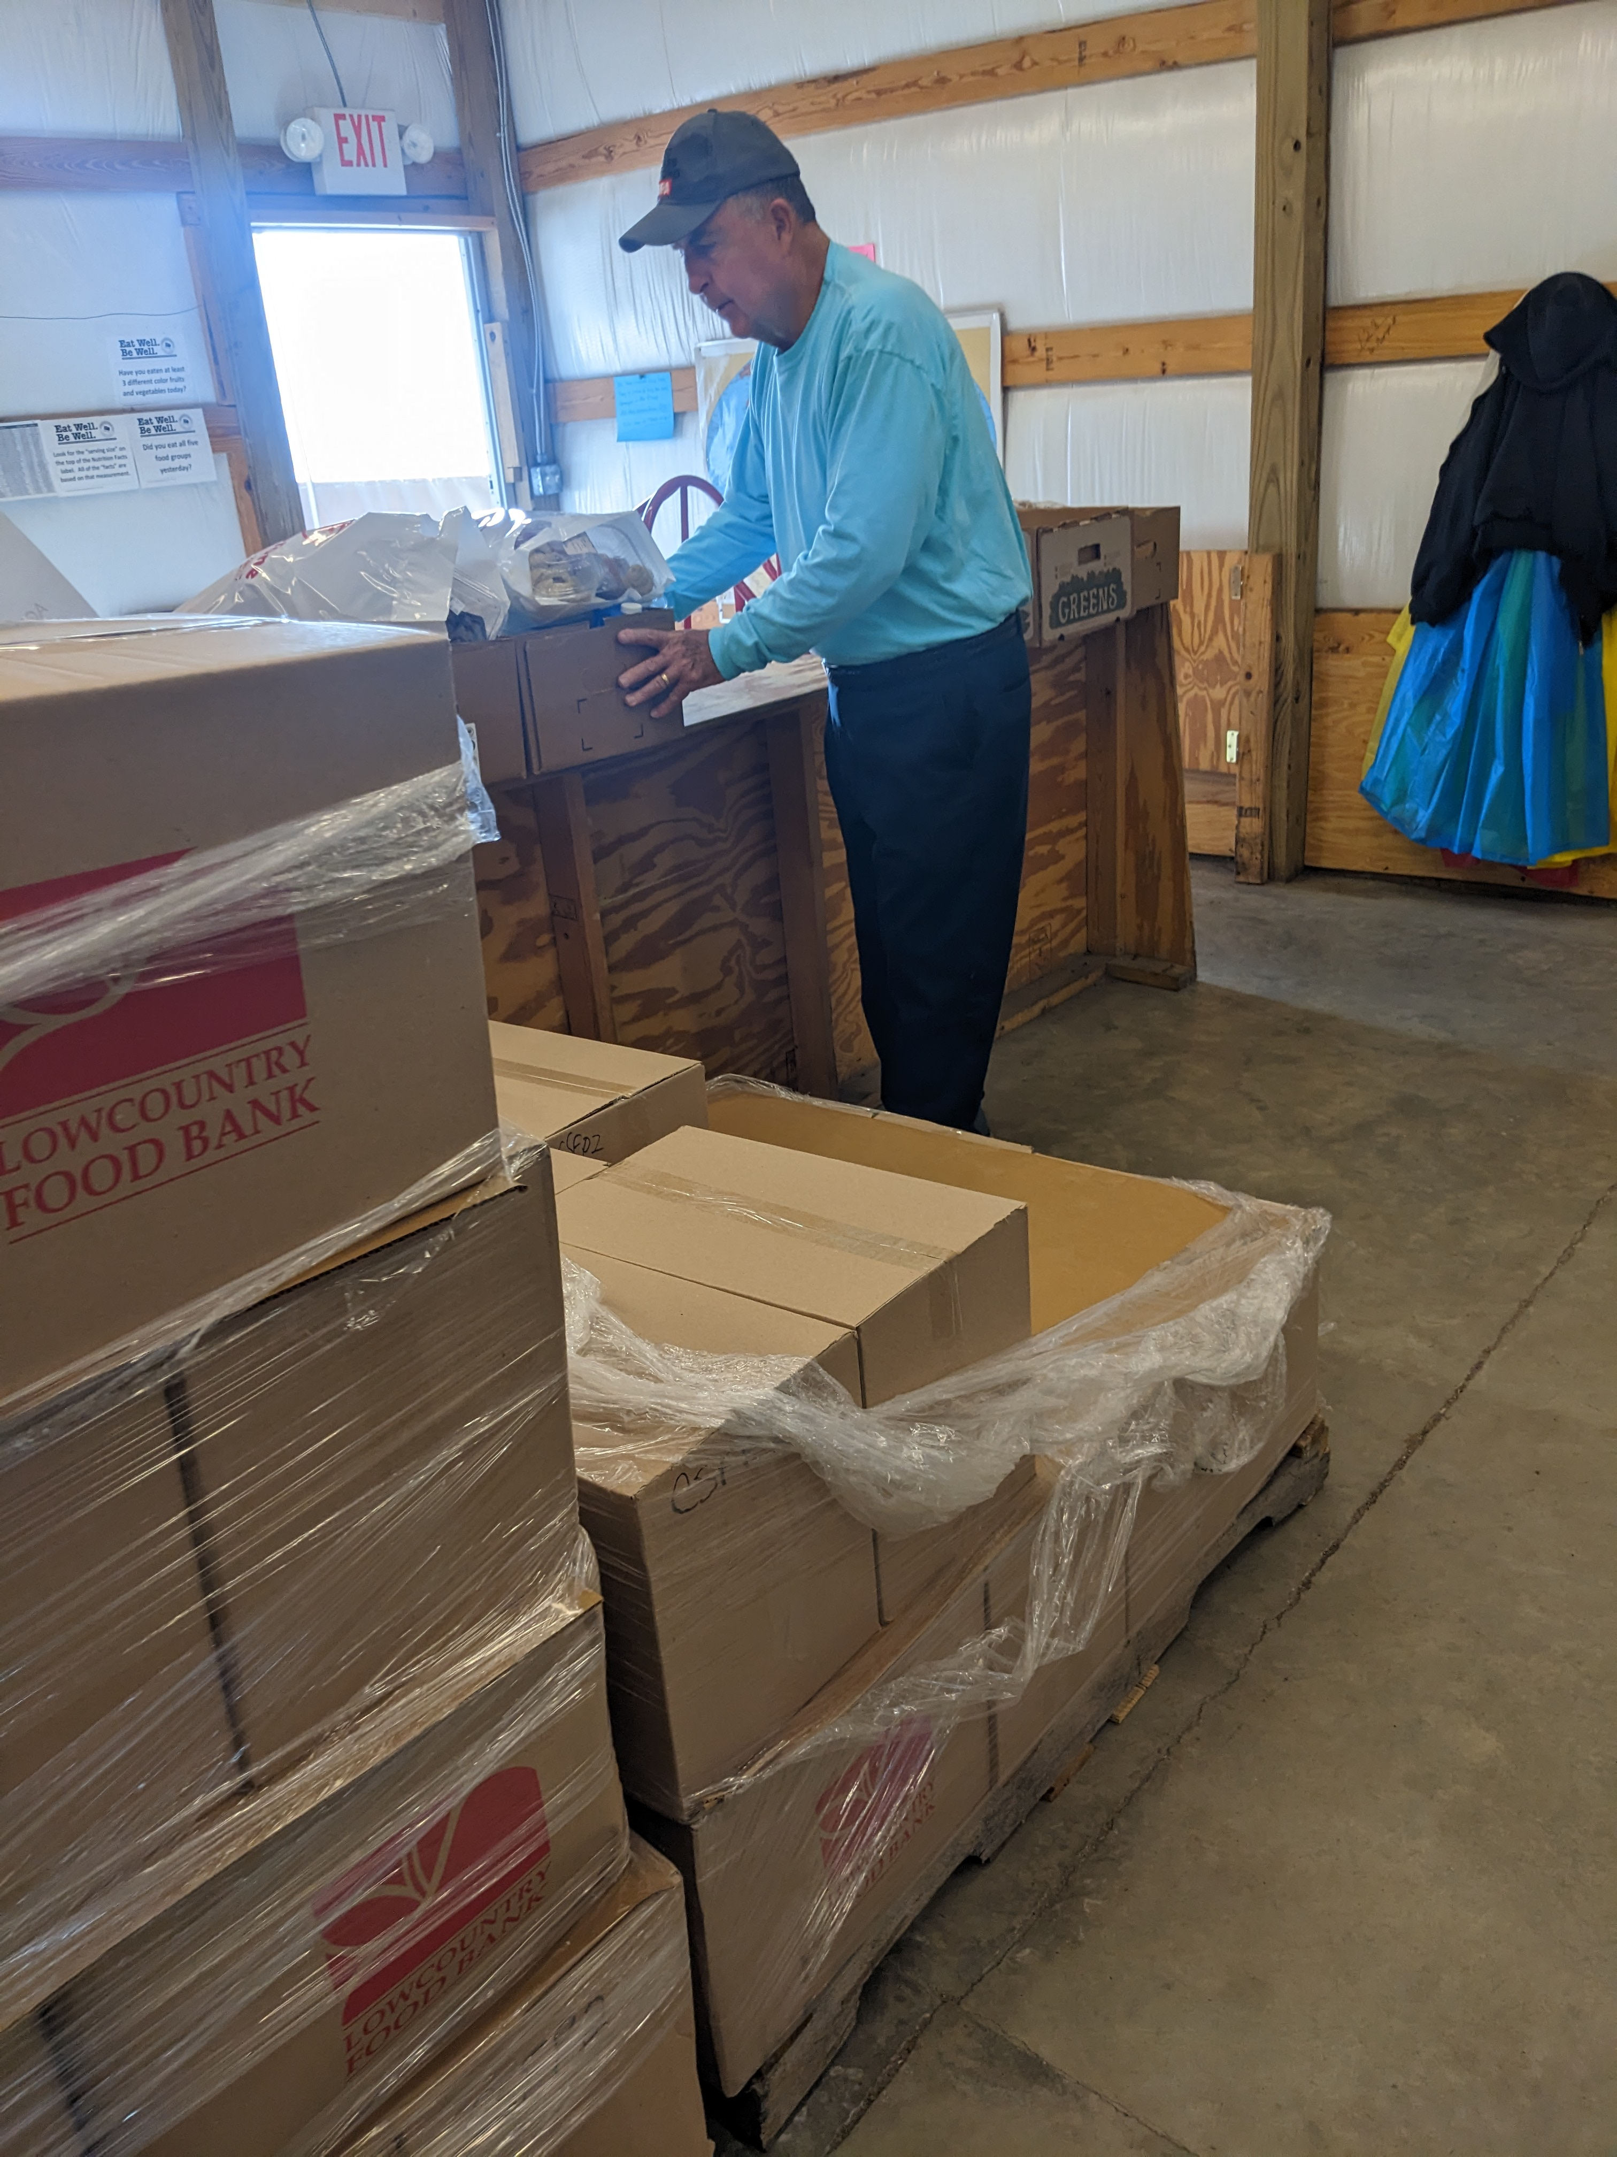
What Hasn’t Changed?
Participants must be 60 years or older and meet income guidelines
  We must ask for age and address verification, but NOT income verification
We must accept new seniors by inputting them into Link2Feed
Anyone receiving a CSFP box must have a CSFP profile in Link2Feed
Clients must be assigned to your site to receive a CSFP box from you

Slide 12
Box Etiquette
Count boxes!
Pest Control- Storage facilities must be sanitary and free from rodent, insect, and other animal infestation; best achieved by contracting with a professional service. Pest log should be kept if done in-house.
Store boxes in a locked area to prevent theft and other loss.
Follow First In, First Out (FIFO) principles.
Boxes should be stored ATLEAST 6 INCHES off the floor.
Maintain foods at proper temperatures. Use refrigerator thermometers and room thermostats
Recommended temperature levels are:
    50° to 70° for dry storage areas
    36° to 40° for refrigerated storage areas

Slide 13
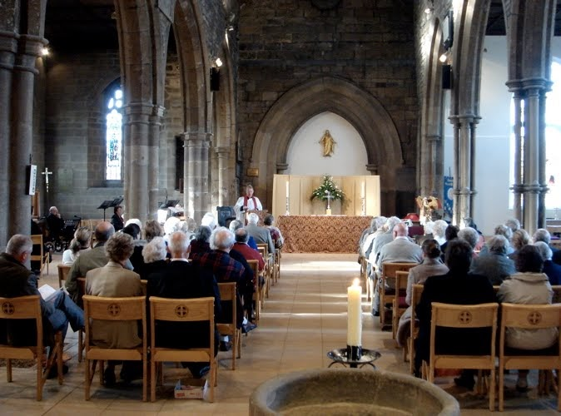
What if I have events going on at my church at the same time as CSFP?
Participants are never required to participate in church services or religious activities, such as praying, in order to receive CSFP
Make sure your church events are separate from food distributions

Slide 14

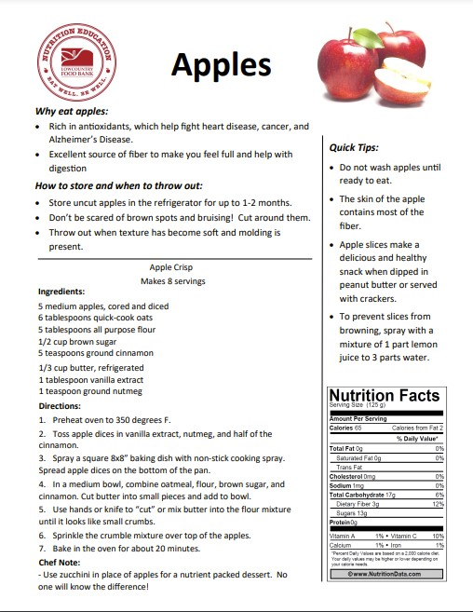
Healthy recipes and other nutrition education materials will be packed into every box!
These materials can also be found on the Lowcountry Food Bank website under the CSFP tab.
LCFB also provides fresh produce for your participants!
  *Since this fresh produce is from LCFB, not the government, leftovers can go to anyone who needs food.

Slide 15

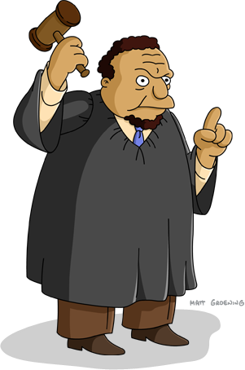
And Justice For All Poster and Civil Rights Training
Annual Civil Rights Training is required for agency operations. To ensure all staff and volunteers are trained, agency managers may:
Conduct training during regularly scheduled meetings
Train new staff and volunteers as they come aboard
Create a review station with an acknowledgement form
A log or sign-in sheet must be completed and retained in order to receive credit for conducting the training.

Slide 16


Civil Rights Training Requirements
Protected Classes
Race
Color
National Origin
Age
Sex
Disability
Training must include the following:
How to assist participants with language barriers?
Use of the interpreter Services poster, Deaf/hard of hearing, Visually impaired, etc. Failure to provide meaningful access can be considered discrimination.
How to assist individuals with disabilities?
Volunteer assistance, wheelchair ramp, etc. Failure to provide reasonable accommodations may subject agency to discrimination claim.
How to differentiate between program complaints and Civil Rights complaints?
Different treatment due to protected classes versus dissatisfaction with program rules.
Conflict resolution
Identification of the issue and calmly communicate with participants on program guidelines
Noncompliance resolution
Corrective actions made to address findings
Customer service expectations
Friendly staff, offering assistance in other areas, develop good listening skills, identify stressors, etc.
All staff and volunteers must know how to assist participants in any of these matters and/or whom to refer questions and concerns to.
Racial/Ethnic Data must be collected at the point of application and reported to determine the effectiveness of the program. It does not affect eligibility.

Slide 17


Public Notification
Nondiscrimination Statement
Each agency is required to provide some form of public notification each year. The full nondiscrimination statement must be included on all public notification materials. Public notification should include agency name, address, contact information, and days and times of operation.
In accordance with Federal civil rights law and U.S. Department of Agriculture (USDA) civil rights regulations and policies, the USDA, its Agencies, offices, and employees, and institutions participating in or administering USDA programs are prohibited from discriminating based on race, color, national origin, religion, sex, gender identity (including gender expression), sexual orientation, disability, age, marital status, family/parental status, income derived from a public assistance program, political beliefs, or reprisal or retaliation for prior civil rights activity, in any program or activity conducted or funded by USDA (not all bases apply to all programs). Remedies and complaint filing deadlines vary by program or incident.
Persons with disabilities who require alternative means of communication for program information (e.g., Braille, large print, audiotape, American Sign Language, etc.) should contact the responsible Agency or USDA's TARGET Center at (202) 720-2600 (voice and TTY) or contact USDA through the Federal Relay Service at (800) 877-8339. Additionally, program information may be made available in languages other than English.
To file a program discrimination complaint, complete the USDA Program Discrimination Complaint Form, AD-3027, found online at https://www.usda.gov/sites/default/files/documents/ad-3027.pdf and at any USDA office or write a letter addressed to USDA and provide in the letter all of the information requested in the form. To request a copy of the complaint form, call (866) 632-9992.
Submit your completed form or letter to USDA by:
(1) mail: U.S. Department of Agriculture, Office of the Assistant Secretary for Civil Rights, 1400 Independence Avenue, SW, Washington, D.C. 20250-9410;
(2) fax: (202) 690-7442; or
(3) email: program.intake@usda.gov.
USDA is an equal opportunity provider, employer, and lender.

Slide 18


Ways to Do a Public Notification
Every Year!
Use our flyer template and fill out your information
Post in a public place in your community (not in your building)
On a separate flyer with your information, write on the back when and where you posted it and keep in your records
Advertise your CSFP on your website​
You must include the full nondiscrimination statement, or provide a link to it​
If on Facebook, it must be in your “About” section

Slide 19


What will Chris Doyle look for at these visits?
Department of Agriculture Site Visits
CHECKLIST
SCDA conducts reviews to ensure agencies are compliant with federal and state regulations. The reviewer will review paperwork, storage area, and may discuss some requirements and recommendations for program operation. Following the review, agency managers should expect to receive a Review Letter detailing any findings, instructions for corrective actions, additional requests, and/or recommendations for more efficient operation.
A response to corrective actions are due within 30 days of receiving the Review Letter. Failure to respond may result in suspension from the program. Unless otherwise noted, all corrective actions must be addressed.
Current Agreement with Food Bank
501(c)(3) or Letter of Good Standing
Civil Rights Training Log & Complaint Procedures
Racial/Ethnic Data Form- Link2Feed Data
Posters (Income Guidelines, And Justice For
All)
Pest Control & Temperature Logs
Monthly Reports & Invoices
Participant Files-Link2Feed and Paper
Recertification
Waiting List
Pickup & Recertification Procedures
Storage & File Organization
Public Notification
Unlike LCFB’s site visits, these visits are pop-in visits during your scheduled distribution times, so BE PREPARED!

Slide 20

South Carolina Department Agriculture Contact
Chris Doyle
803-734-0328
cdoyle@scda.sc.gov
Mailing Address
P.O. Box 11280
Columbia, SC 29211

Slide 21

Lowcountry Food Bank Contacts
Please email all CSFP questions to gbrown@lcfbank.org
Gabby Brown, Agency Relations Coordinator
Office: 843-747-8146 ext 121

Slide 22
Question!
What’s the most common error when adding a new client into Link2Feed?
The blue “Certify” button

Slide 23
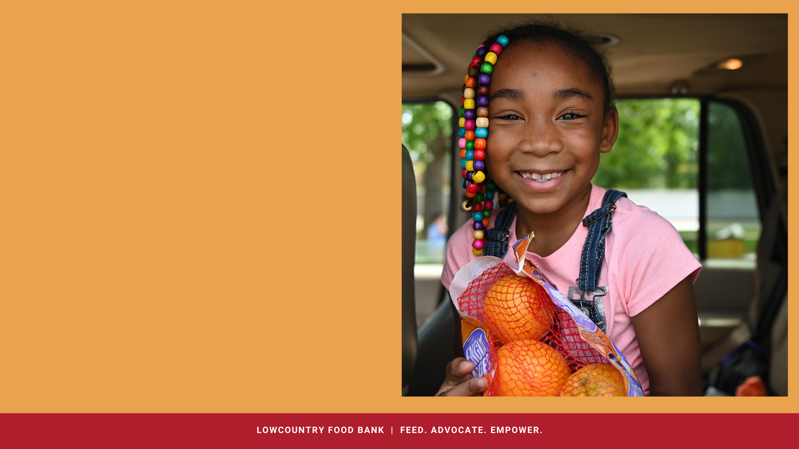
Link2Feed Reminders
Wait List
  Inform clients they are not guaranteed a box if they are on the Wait List, but they can get a box if there are any leftovers.
  If a Wait List senior picks up a box, move them to the Active List and inform them they are now guaranteed a box and must come each month to pick it up.
  Set up a time frame for Wait List Clients to get boxes.
  Contact Wait List Clients to get boxes.

Slide 24
Link2Feed Reminders
Suspended Status
  Happens automatically in Link2Feed
  You will only be sent enough boxes for your active list
  You CAN give a box to a suspended client if you have extras.
    You will not be able to record their visit in Link2Feed until you change them back to active status in Link2Feed.
Each site is responsible to add new clients into Link2Feed, mark clients as closed or deceased, to keep their waiting list clean and to add new users

Slide 25


Do we need to prove CSFP Income?
NOPE!
Income is self-stated
and we do NOT need
proof or documentation.

Slide 26

Recertifications
Recertification makes sure participants are still eligible for the program
Recertification happens in January each year
It is helpful to prepare staff, volunteers and clients that wait times might be slightly longer in January

Slide 27
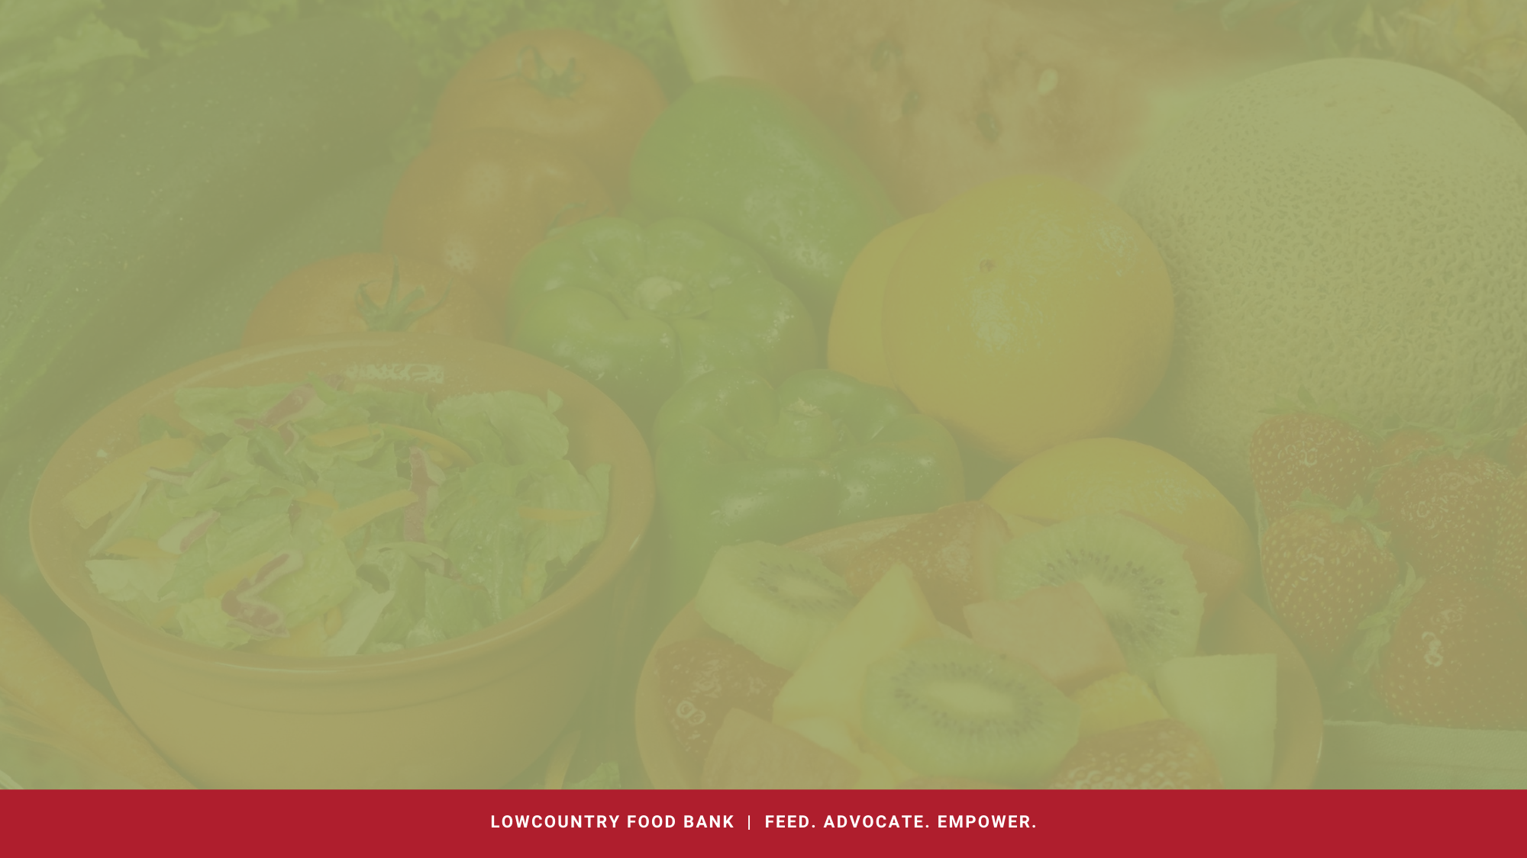
Link2Feed Live
Pros to using Link2Feed Live
Live client list-not outdated
More accurate visit numbers
No data entry after your distribution
Gets clients used to Link2Feed (TEFAP)
More accurate data collection
No paper storage
You don’t have to print your Issuance Register
No double recording between sites.
You will no longer be able to use the Attendance feature to backdate. All clients will need to be recorded individually.

Slide 28

Client Files
If you are NOT recording CSFP Client Visits LIVE at the time of distribution, you MUST keep all issuance registers, applications, closure letter, proxy forms and transfer letters on file at your agency for three years.

Slide 29
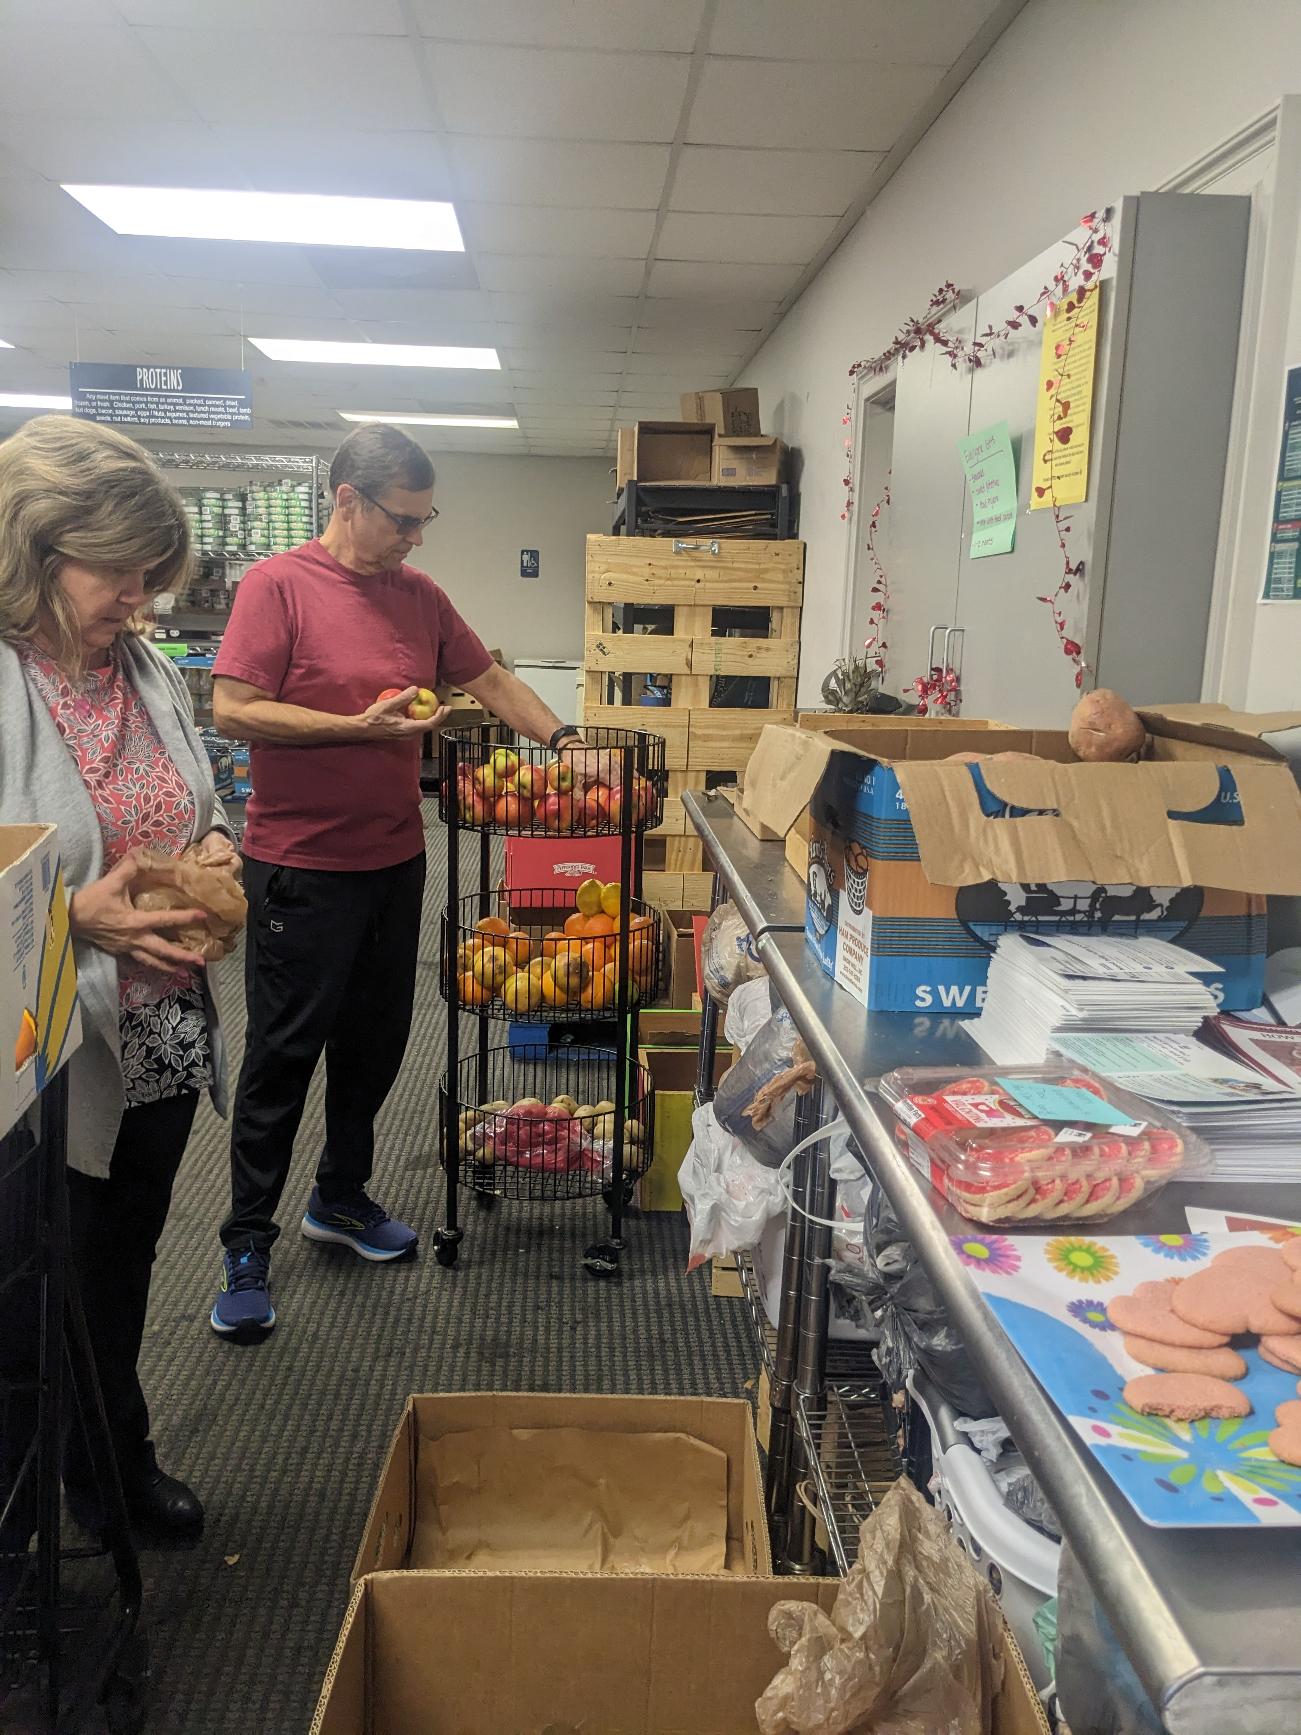
Closure Procedures
Participants who do not pick up two months in a row will automatically be moved to suspended status. When a client doesn’t pick up after 3 months, they will be moved to the waiting list. Clients should be closed in Link2Feed if they haven’t picked up in 3 months and are on the waiting list.
If a client has not come to your site for several months, exceeding two missed months or have asked to be removed please send them a closure letter.
Agencies, and NOT LCFB are responsible for sending closure letters and maintaining suspended and waiting list clients

Slide 30

Reporting Deadline
You must turn in your report by the 25th of each month unless you've been notified your date is the 18th
This includes the google form and putting your visits into Link2Feed.
We will be sending out a new reporting form. Please bookmark this new form, as the old one is no longer needed.

Slide 31
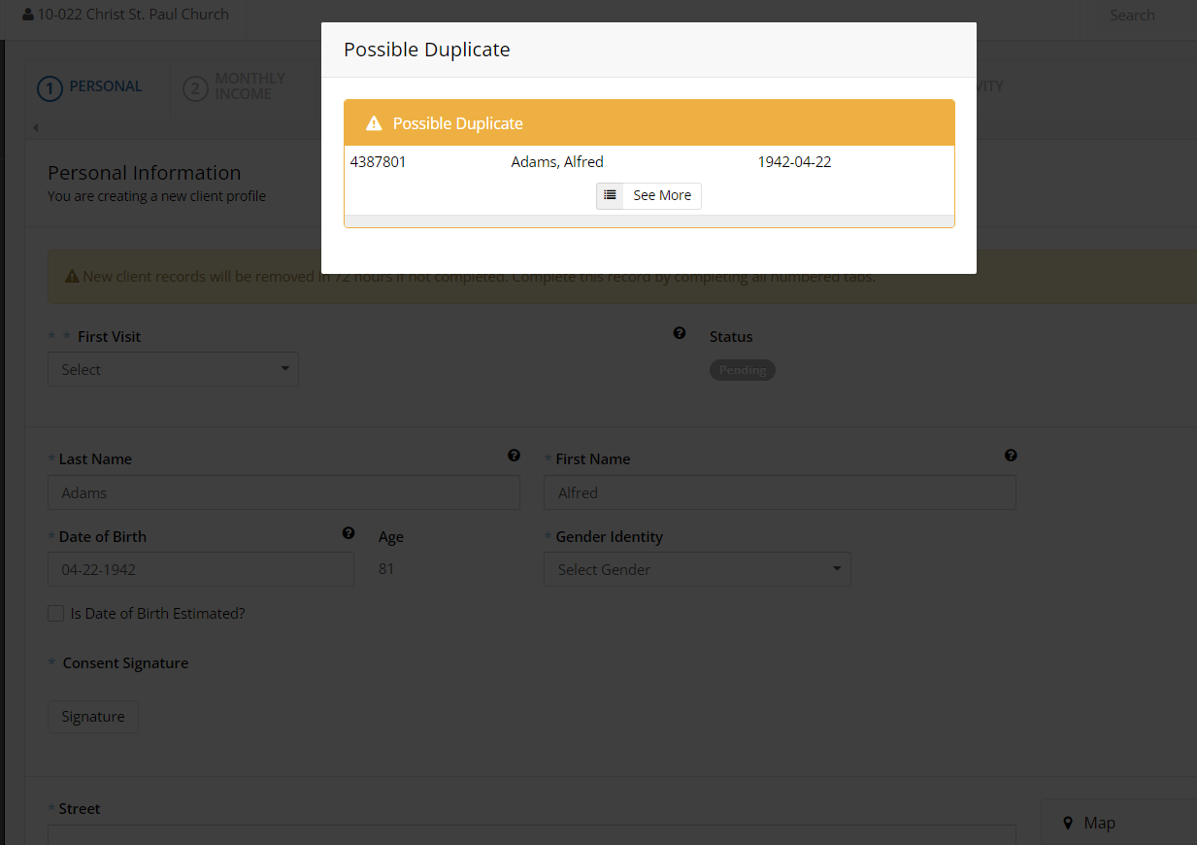
Creating Complete and Thorough Profiles
Must collect all personal information
  Should NEVER choose "Didn't Ask" or "Don't Know"
Must correctly spell all names. Do NOT include nicknames or middle names/initials. Check ID for spelling.
Must ensure that the client is not already in Link2Feed by checking name and birthdate before creating a profile. This helps to prevent duplicates.
Never dismiss the Duplicate alert

Slide 32
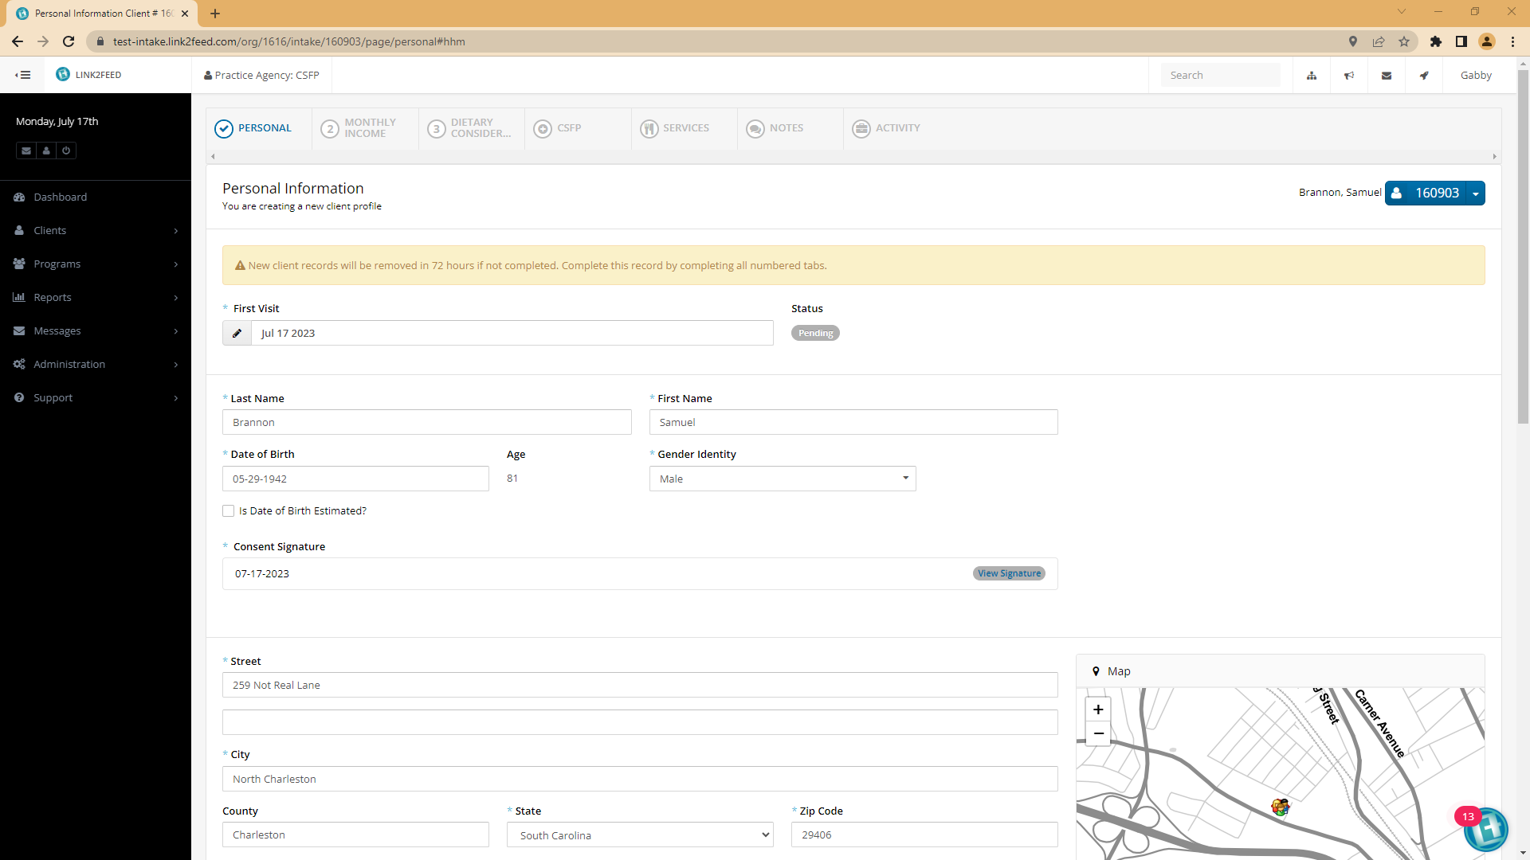

Slide 33
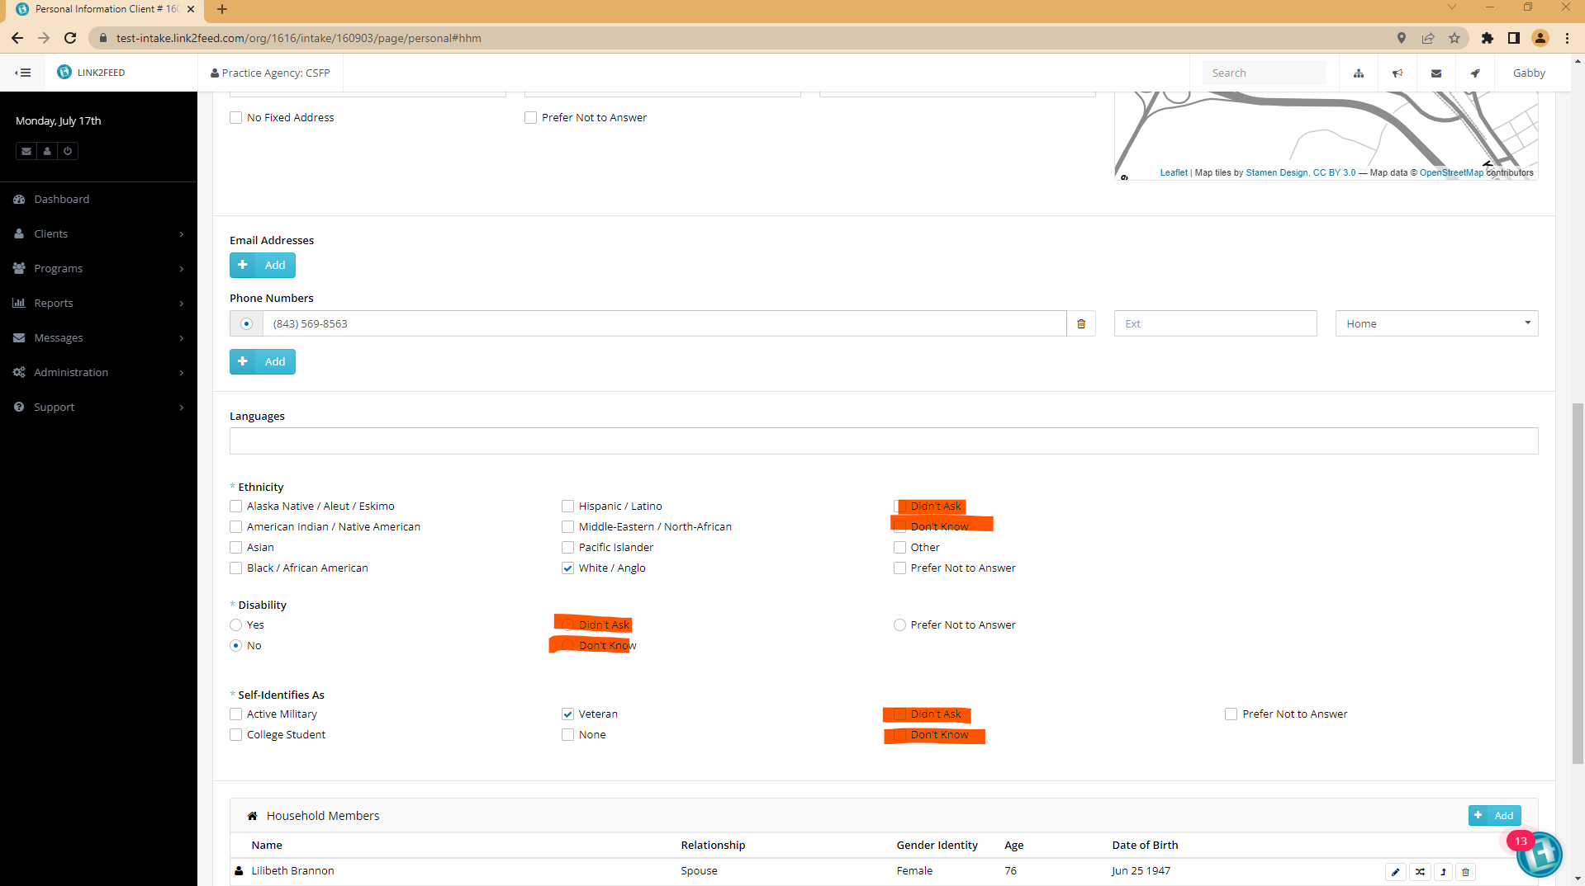

Slide 34
Creating Complete and Thorough Profiles
Must input ALL Household Members.
  This is required by the USDA.
  Reminder: Household Members are defined as those that regularly cook together and share food. This does not have to be someone that lives in the same house, it also may not apply to some in the same house.
    For example: Betty has dinner at her grandmother's house every night but does not live with her. She is still considered a household member.
    For example: Margaret and Jennifer are roommates. They live in the same house but do not share food. They are not considered household members.

Slide 35

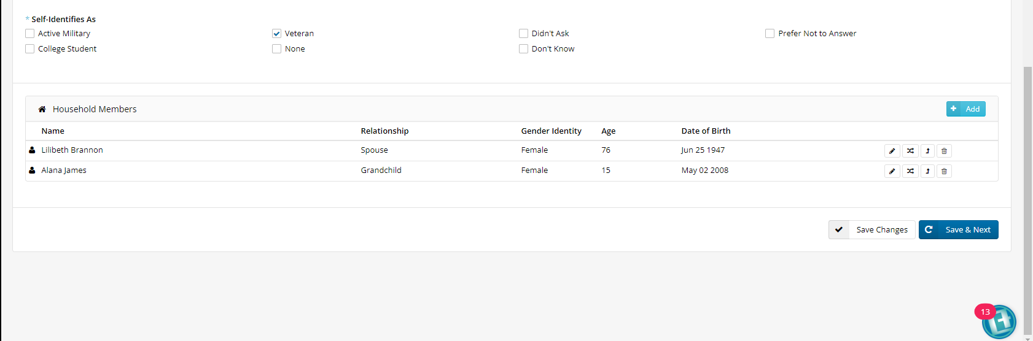
Where to see Household Members

Slide 36
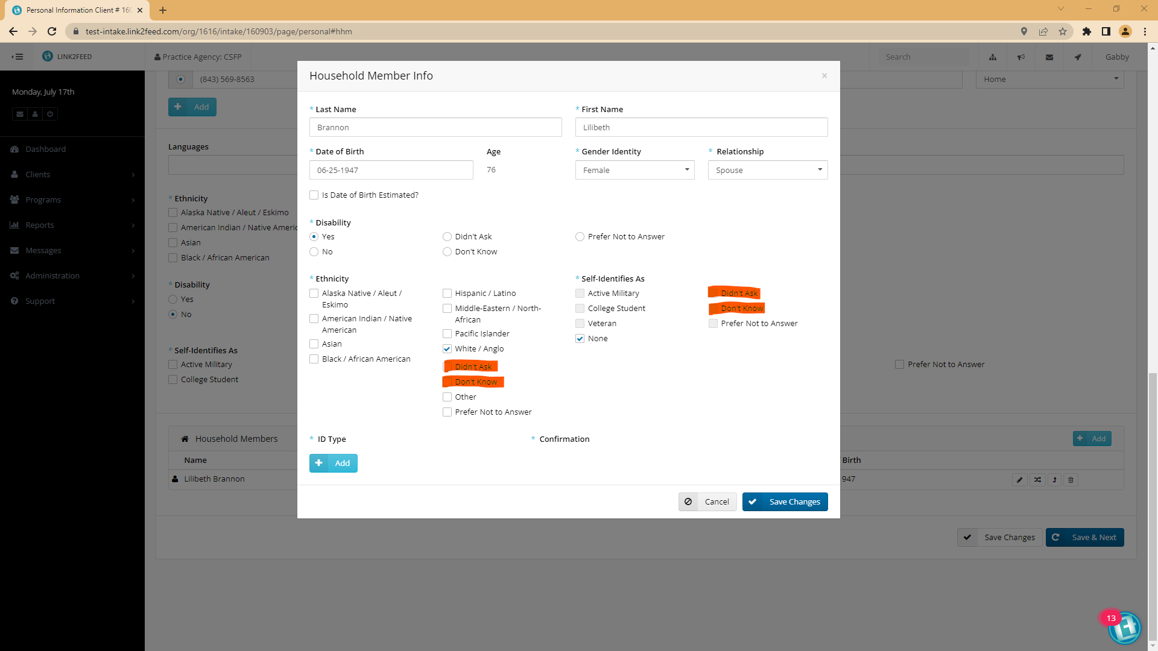

Slide 37
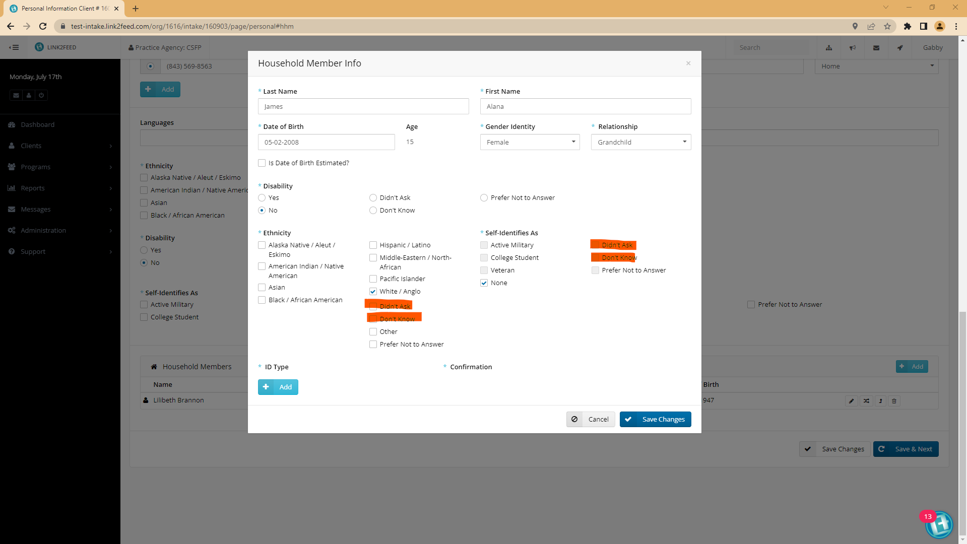

Slide 38
Question!
What is the procedure for closing CSFP clients?
After 3 months they will be moved to the Waiting List, once there you will close them and send a closure letter.

Slide 39
Creating Complete and Thorough Profiles
Add Proxies (Authorized Individuals)
Each participant may assign two people (proxies) to pick up their box on their behalf.
Proxies are now able to pick up for more than two people.
CSFP Site Directors may not be proxies

Slide 40
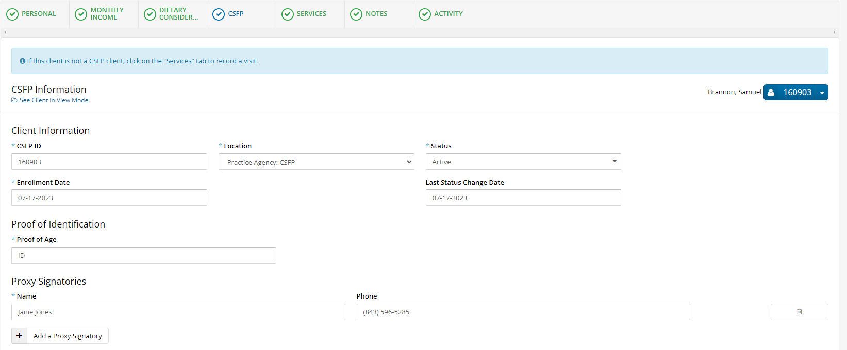
Adding Proxies

Slide 41
Next Steps
You will be sent an email shortly that includes, these slides and attachments of documents that we talked about today, as well as some additional information

Slide 42
Practice Time!
Help us create a few neighbor profiles and get them enrolled in CSFP.
Ensure that no mistakes are made, you will be called on randomly.

Slide 43
What did you learn?
Please go to: https://forms.gle/b6hRtGv58PRwmLek9
Complete the 10-Question assessment
You must get a 100%
You may take the quiz as many times as needed

Slide 44
Thank You!

