Slide 1
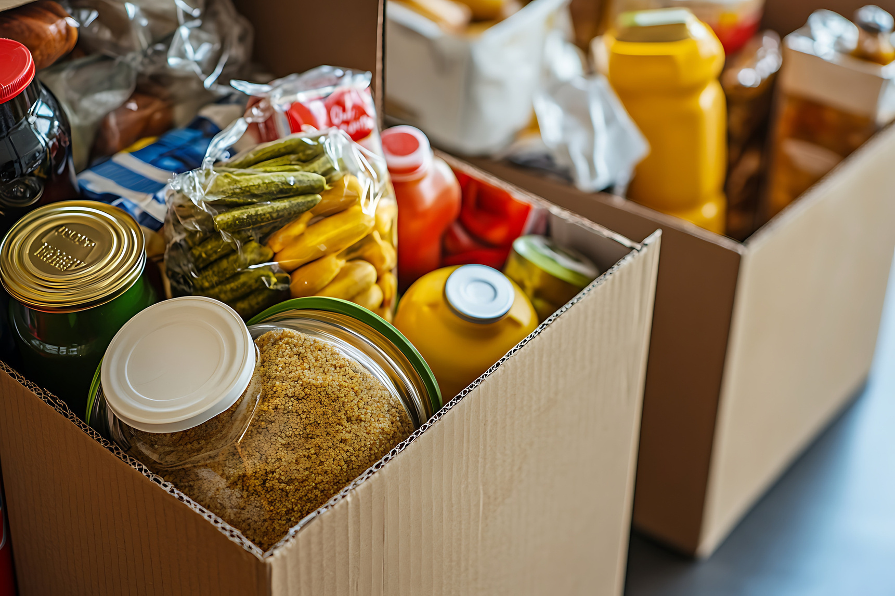




Welcome to Our Food Pantry!
We Are Happy You Are Here!

Slide 2




Get connected
to a variety of services across the state:
food, clothing, shelter, health care, financial support, legal services, etc.
3 EASY WAYS TO CONNECT:
    Dial 2-1-1 to talk to a Community Navigator
    Text HELP to 211-211
    Visit www.sc211.org
South Carolina
Notes:
1.7.2013
2
‹#›

Slide 3
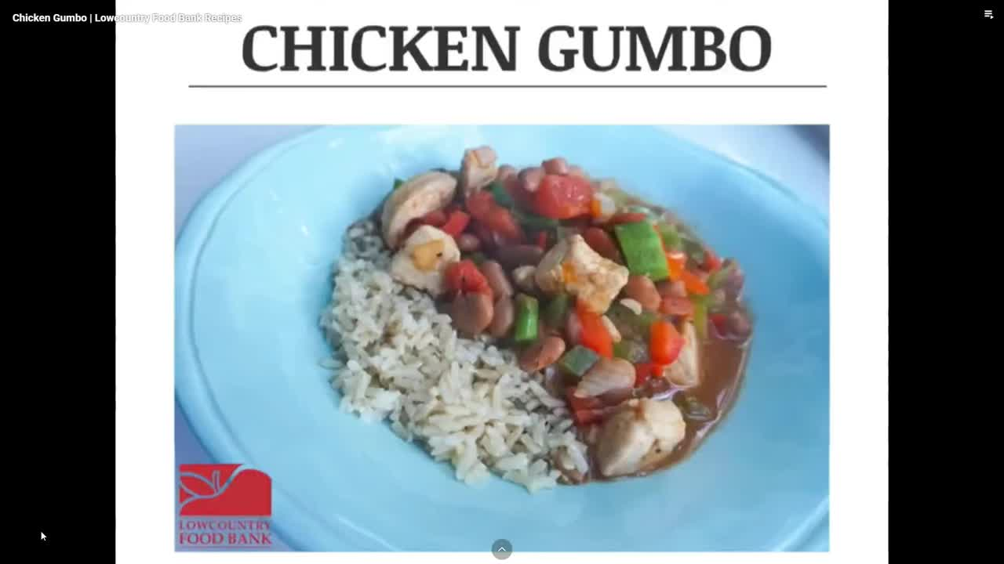


Looking for EASY
and Healthy meal ideas...
Scan for
Lowcountry Food Bank Video Recipes

Slide 4
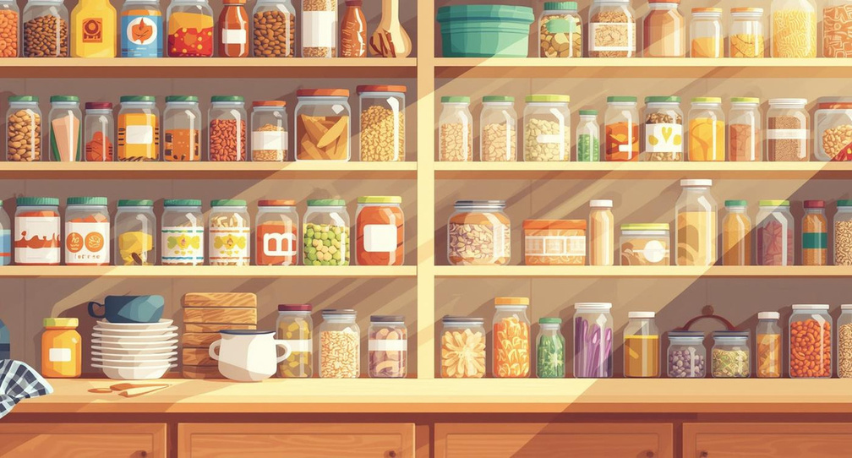
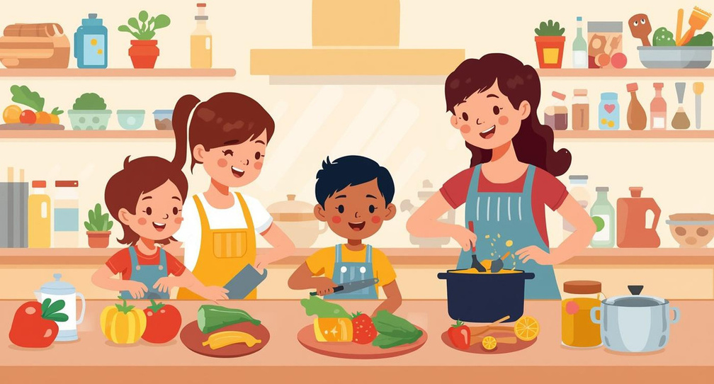
Healthy Cooking with
Pantry Staples
MIX AND MATCH
GET CREATIVE
Combine pantry staples for delicious meals and snacks.
Use simple recipes to explore new flavors together.

Slide 5
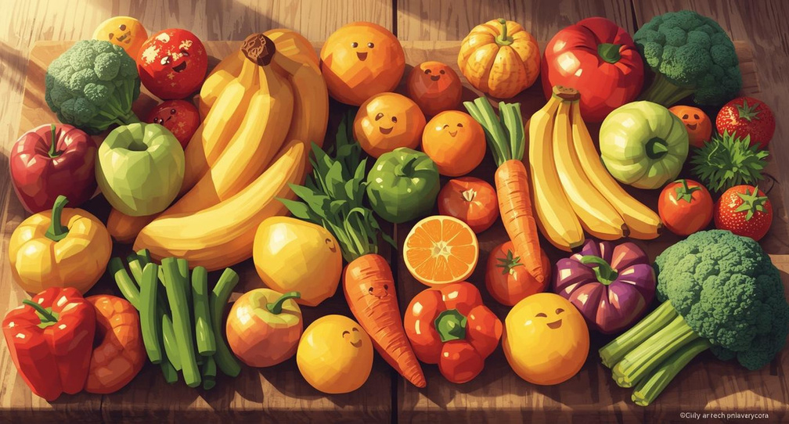

Choose Colorful Fruits and Vegetables
NUTRIENT-RICH CHOICES
PROMOTE HEALTHY HABITS
Fruits and vegetables provide essential vitamins and minerals.
Eating a variety supports overall health and wellness.

Slide 6
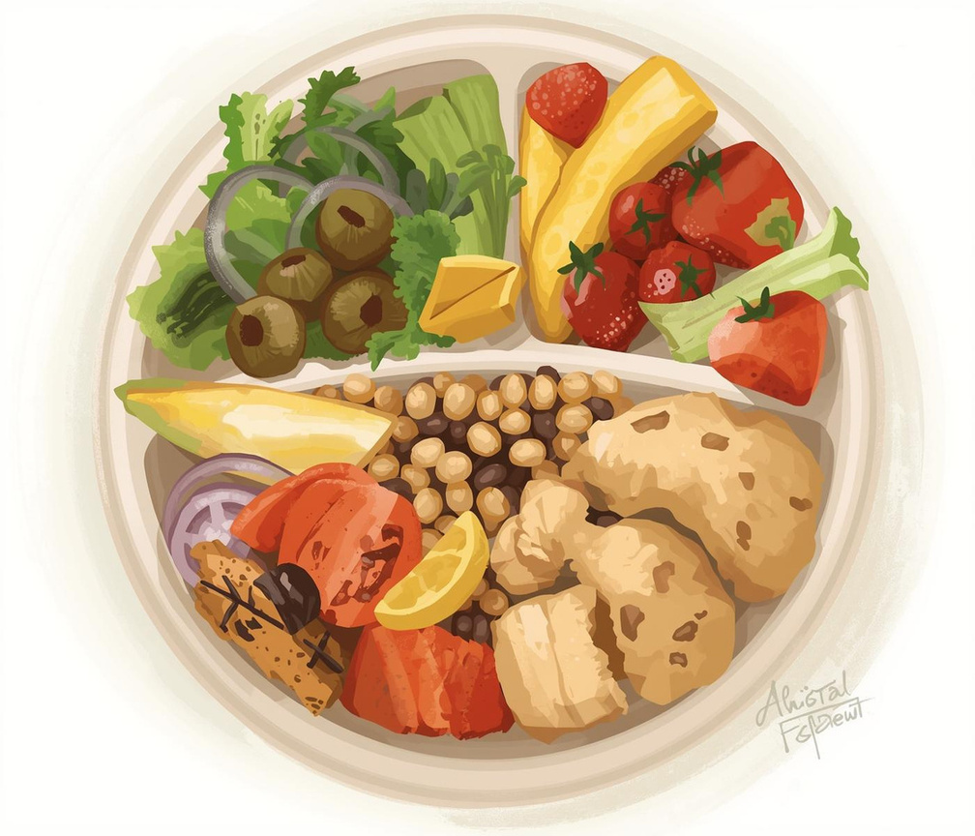
Portion Balance on Your Plate
BUILD YOUR PLATE WITH VARIETY
Aim for half fruits and veggies on your plate.

Slide 7
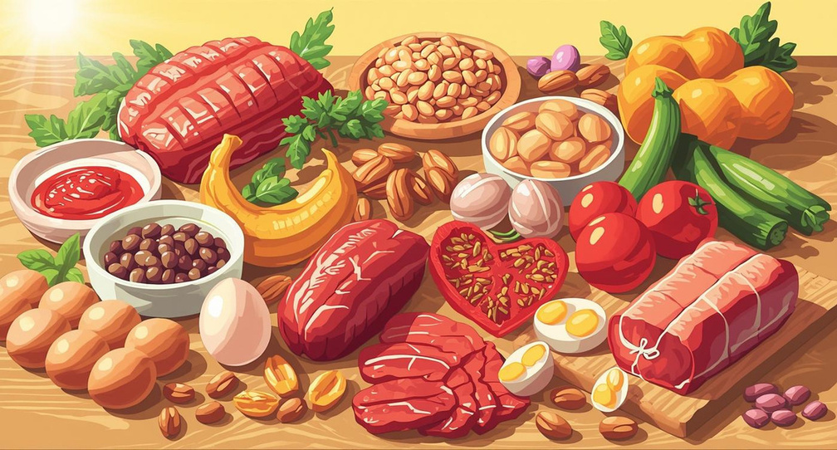
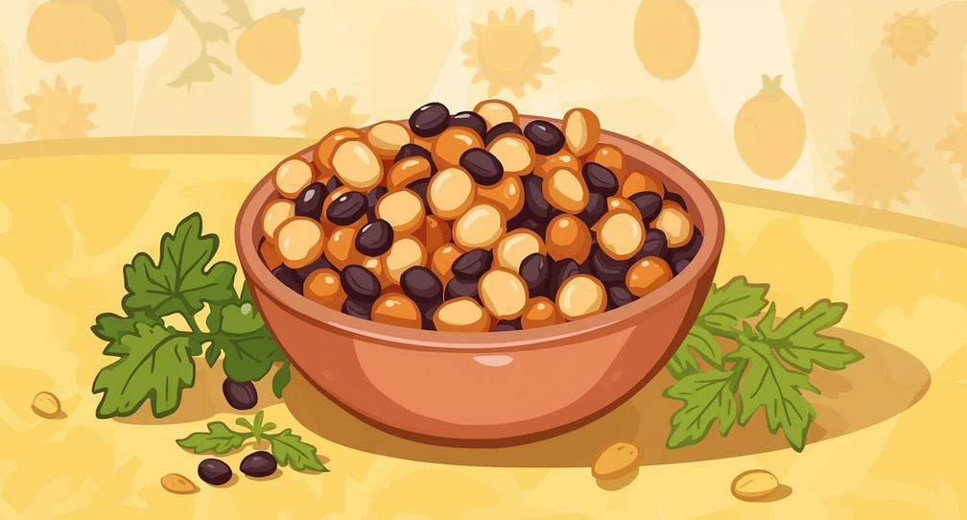
Fun Facts About Proteins
BUILD STRONG MUSCLES
SUPPORT GROWTH AND DEVELOPMENT
Proteins help repair and build muscle tissue.
Essential for children's growth and healthy bodies.

Slide 8
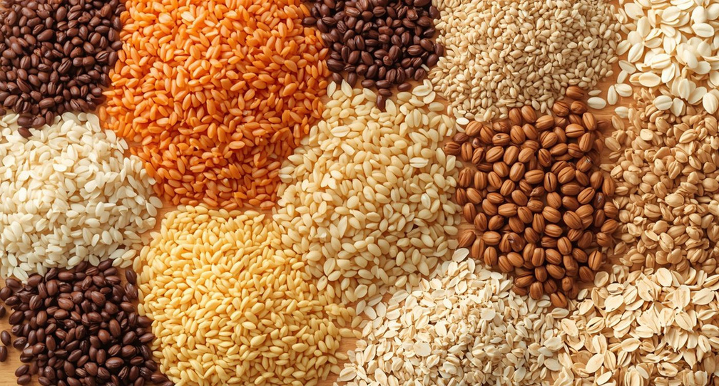
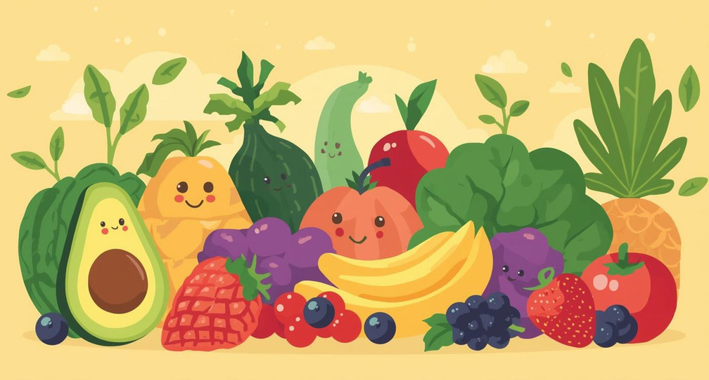
Fiber and Healthy Grains
WHOLE GRAIN GOODNESS
FIBER-RICH FOODS
Whole grains provide essential nutrients and energy.
Fiber helps with digestion and keeps you full.

Slide 9
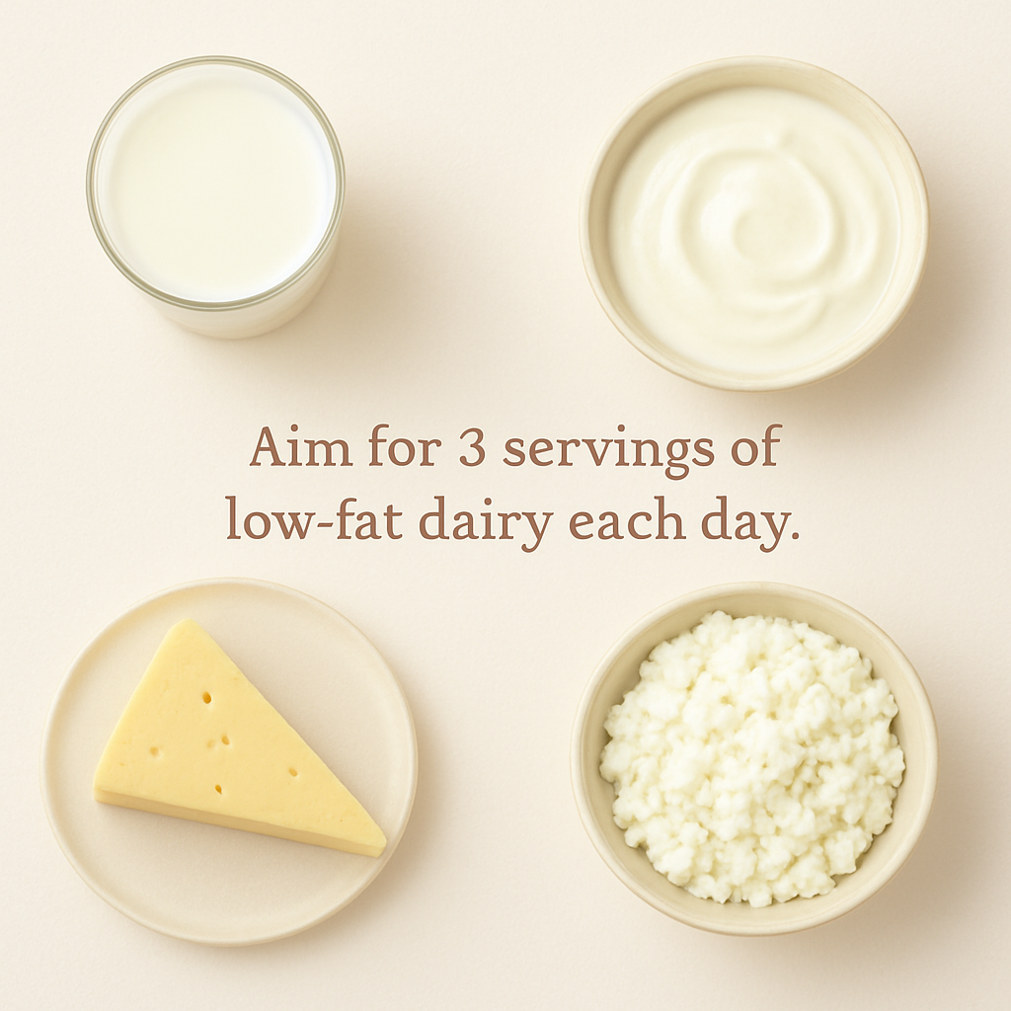
Low Fat Dairy

Slide 10
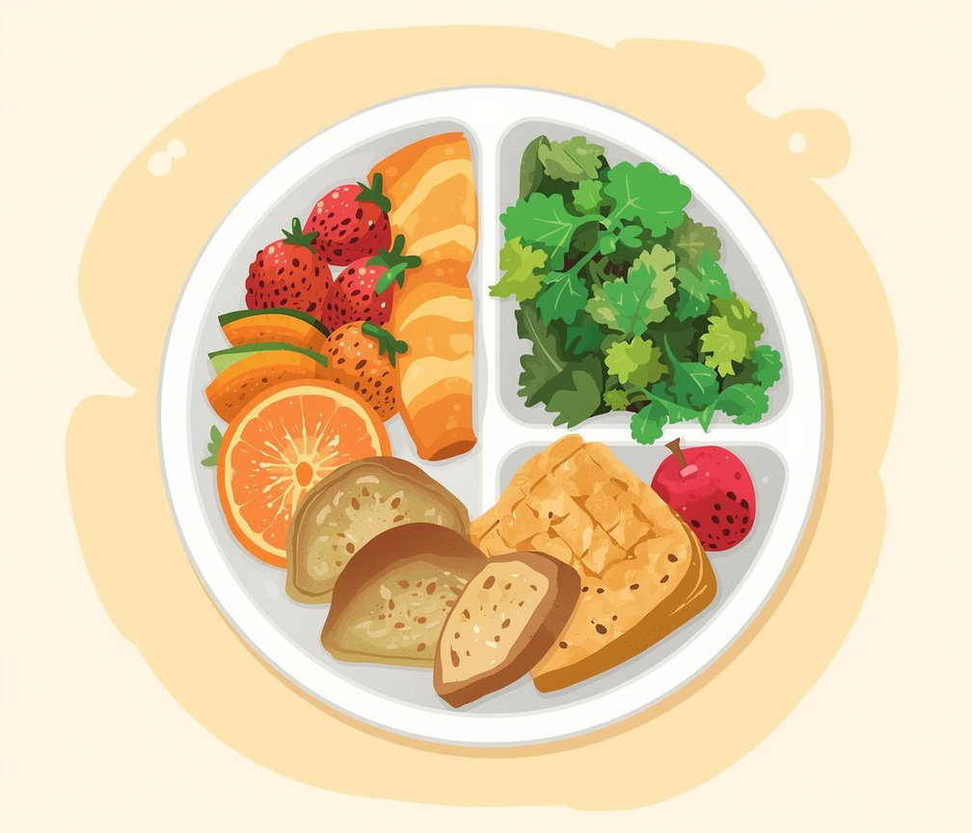
Balanced Meals for Everyone
BUILD YOUR PLATE WITH COLORS
A variety of foods is essential for health.

Slide 11
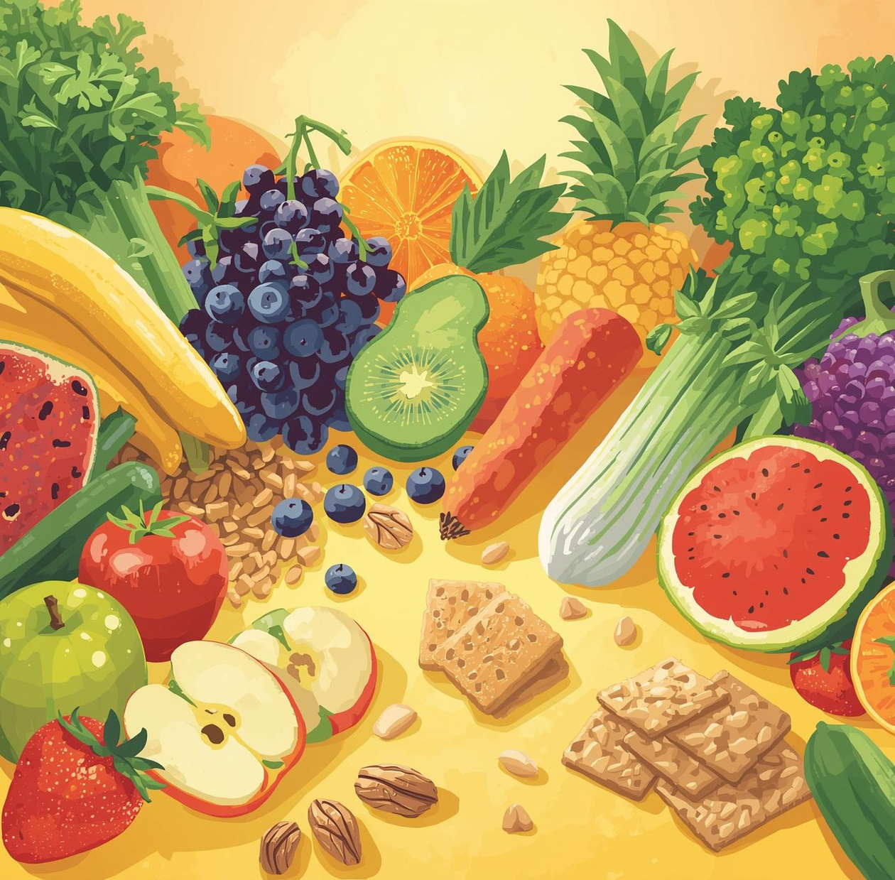
Cut Back on Sugars
Reducing added sugars and salt can lead to healthier choices and improved overall well-being for everyone.

Slide 12
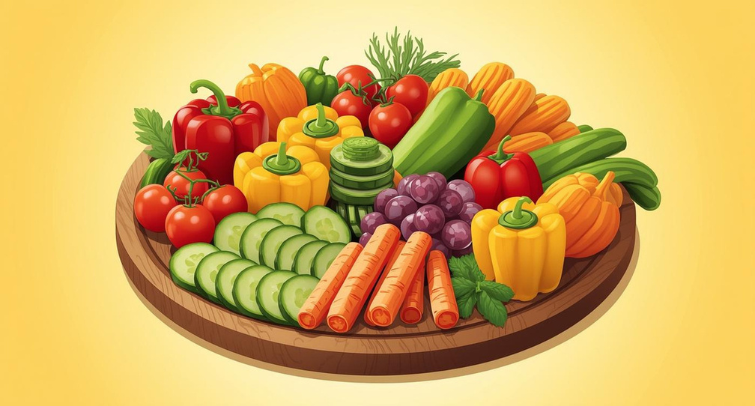

Fun Ways to Enjoy Fruits and Veggies
CREATIVE SNACKS
FUN KABOBS
Prepare colorful veggie sticks for fun snacking!
Assemble fruit skewers for a tasty treat!

Slide 13

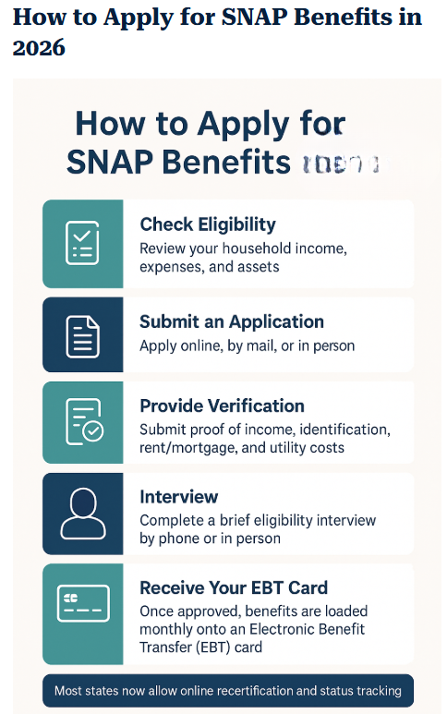
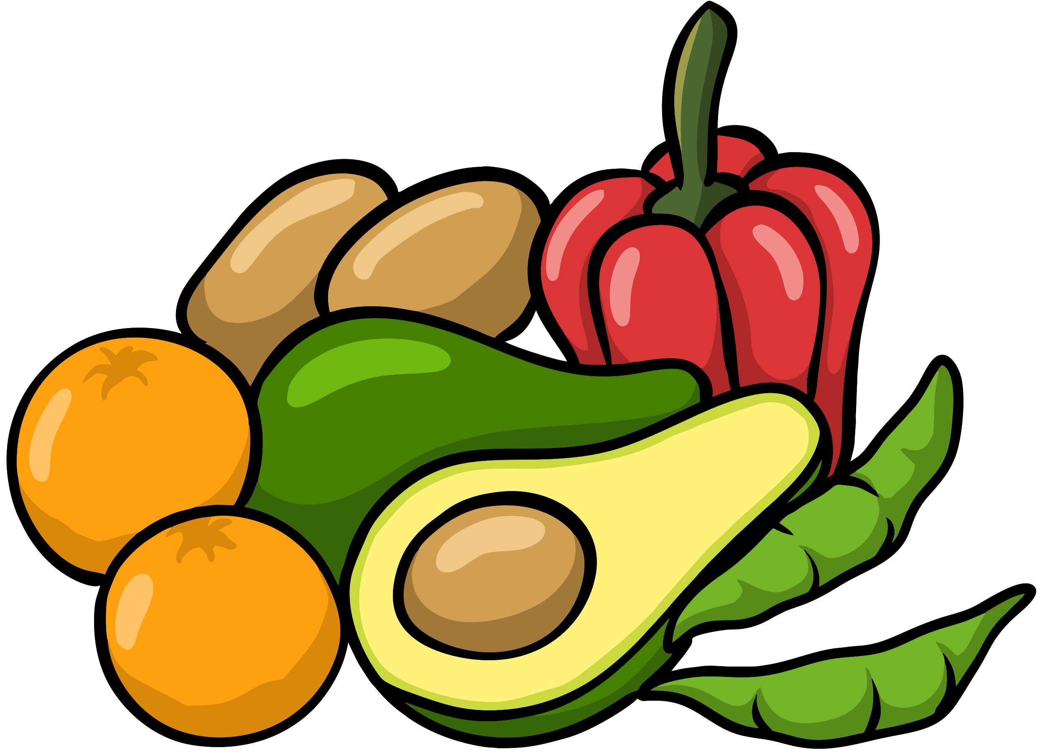

With SNAP, you and your family can...
      Buy healthy and delicious food at most grocery stores and farmer’s markets
      SNAP benefits look and work like a debit card
      Receive benefits monthly
SCAN to learn more

Slide 14


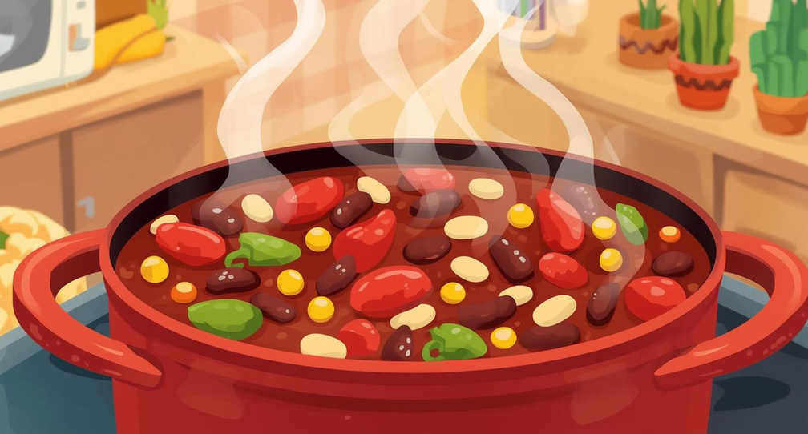
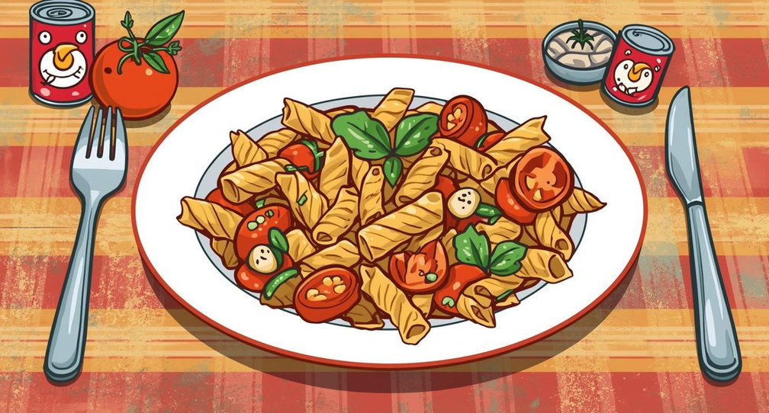
Simple Recipes with Pantry Staples
HEARTY BEAN CHILI
VIBRANT VEGETABLE PASTA
Packed with protein and flavor from beans.
Easy to prepare with fun, colorful ingredients.

Slide 15
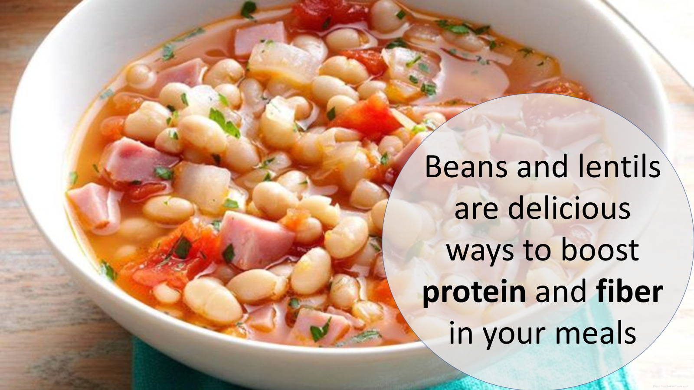
Don’t forget to get your BEANS!

Slide 16
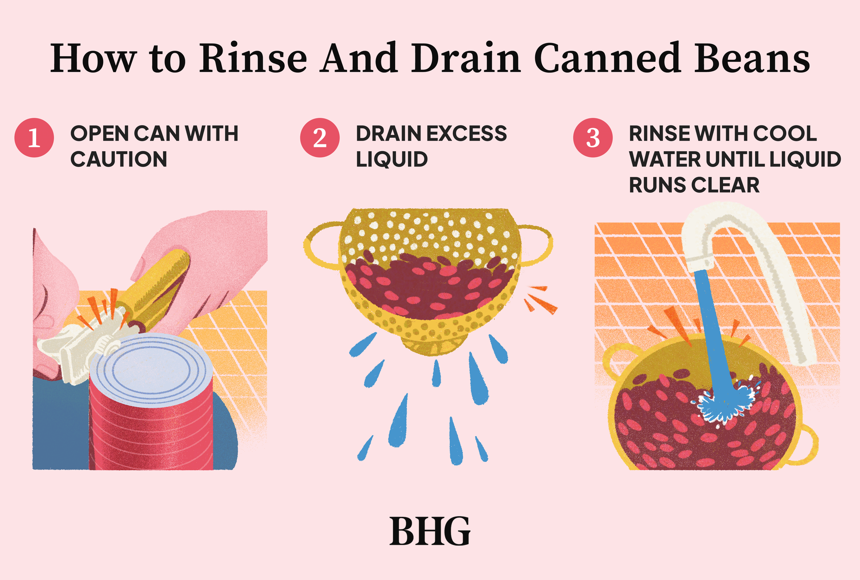
*Rinsing helps to reduce the sodium amount

Slide 17
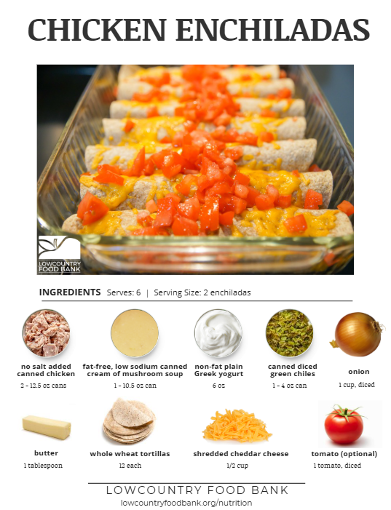
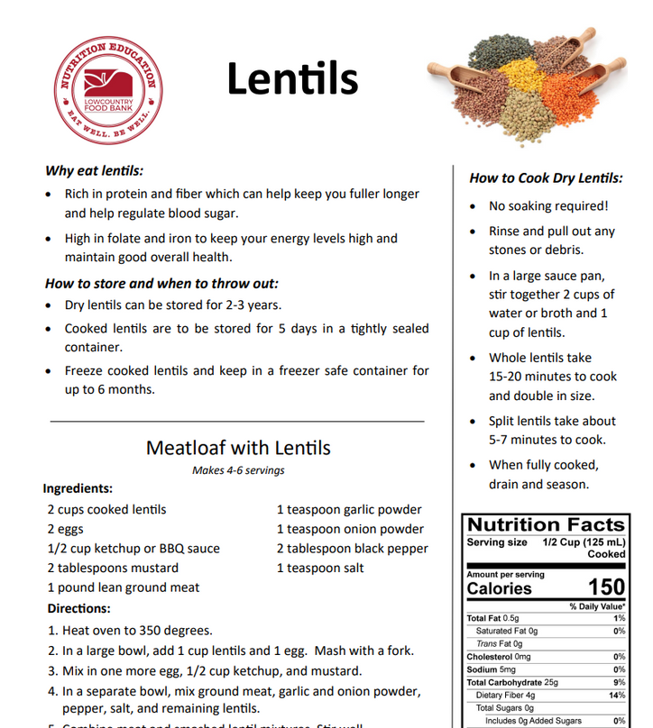
How to get GREAT Recipe Cards like THESE!
A Volunteer
ASK

Slide 18

Stay Hydrated for Better Health
HYDRATION SUPPORTS OVERALL WELL-BEING
Drinking water boosts energy and health daily.

Slide 19
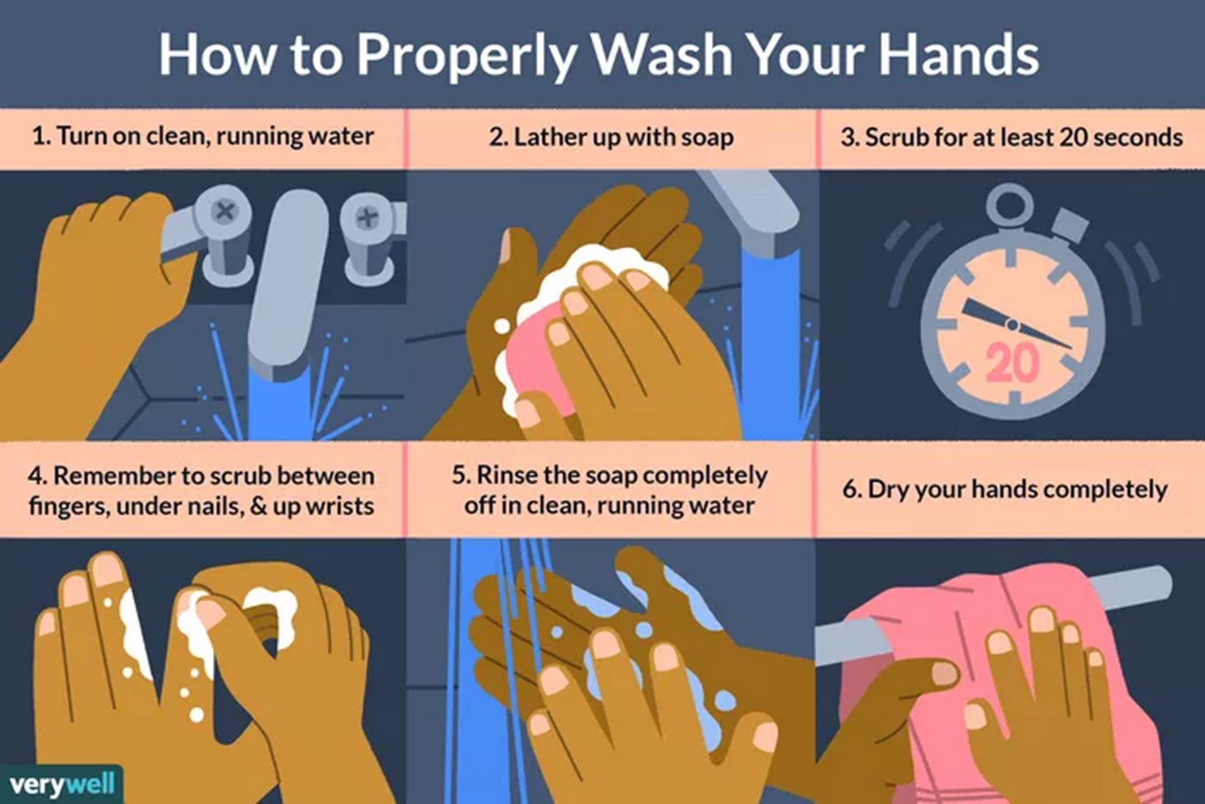
Safe Food Handling Practices
CLEAN HANDS ARE ESSENTIAL
Always wash hands before cooking!

Slide 20
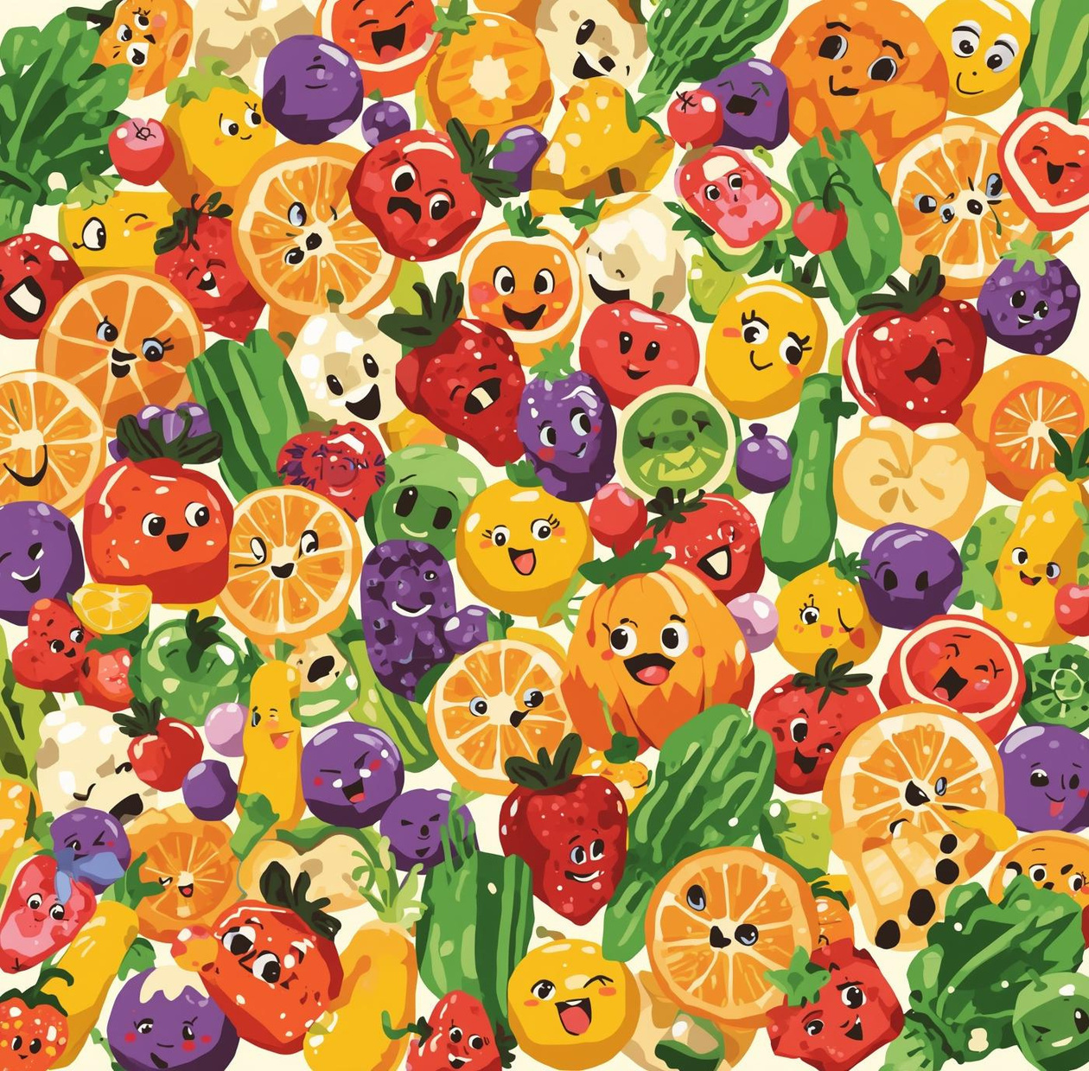
Small Changes Matter!
Simple adjustments to your diet can lead to big improvements in health and well-being for everyone.

